Slide 1

PLUGGING INTO THE FUTURE :
AN EXPLORATION OF ELECTRICTY CONSUMPTION PATTERNS

Slide 2
TEAM MEMBERS
KANCHARLA LIKHITHA-20NM1A0237(TEAM LEAD)
GUNDAM SUSHMA-20NM1A0232
GUMMADI MADHAVI-20NM1A0231
GRANDHI SRI HARSHITHA-20NM1A0230
GIRI VARSHA SRI-20NM1A0230

Slide 3
India is the world’s third-largest producer and third-largest consumer of electricity.
During the financial year 2019-20, the total electricity generation in the country was 1,598TWh, of which 1,383.5 TWh generated by utilities.
The gross electricity consumption per capita in FY2019 was 1,208kWh.
In light of the recent COVID-19 situation, when everyone has been under lockdown for the months of March to June the impacts of the lockdown on economic activities have been faced by every sector in a positive or a negative way.
The dataset is exhaustive in its demonstration of energy consumption state wise.

Slide 4
Analysing Electricity Consumption in India from Jan 2019 till 5th December 2020.This dataset contains a record of Electricity consumption in each states of India, here we are going to analyse State wise, Region wise and Overall Electricity consumption in India.
I uploaded my dataset in MYSQL Workbench 8.0 CE app and analysed the data in Tableau app through the connection by SQL Server Management Studio and I uploaded the data into Web page edited my HTML code which I took the code from Arsha web page using Visual Studio. And I connected it through Flask in Spyder compiler and generated a Web page code. In that Web page I inserted my total analysis part of 2019-2020 Electricity Consumption.

Slide 5
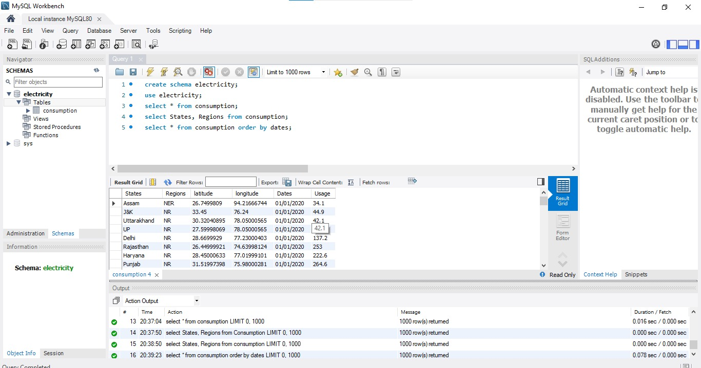
STORING DATA IN DATABASE USING SQL

Slide 6
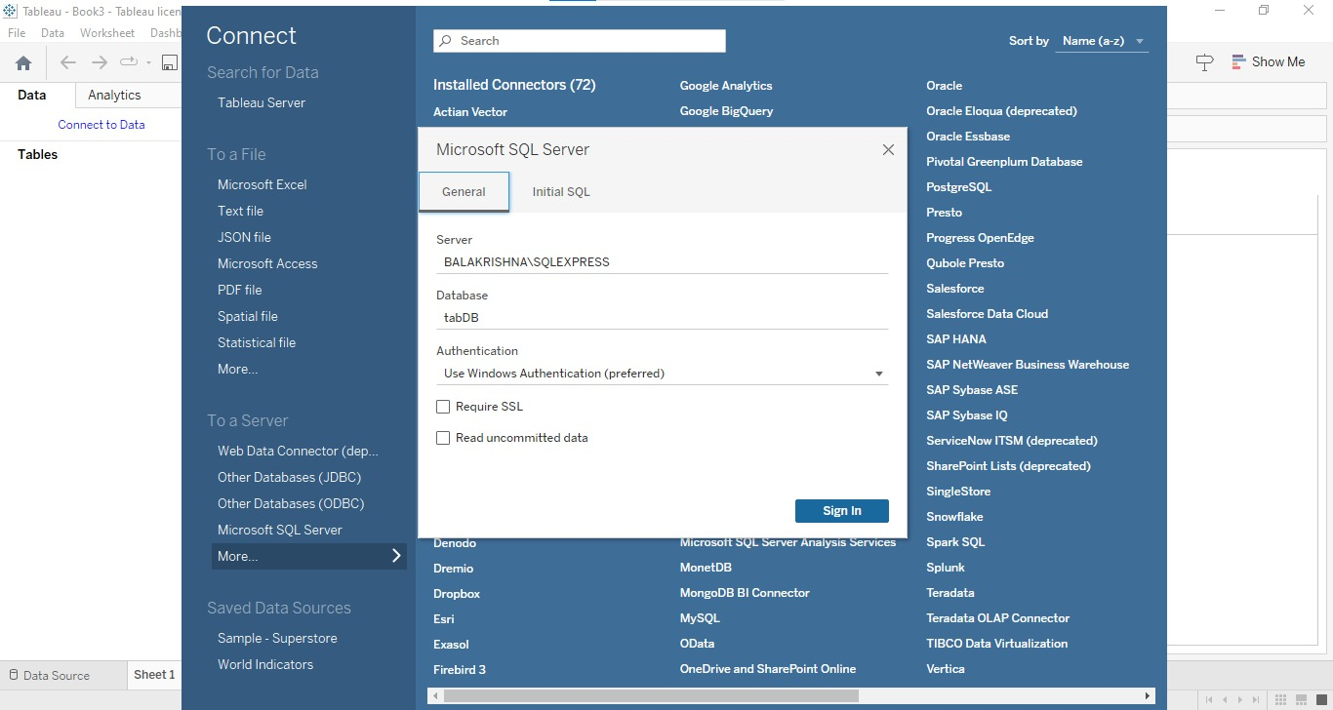
CONNECTED THE DATABASE TO TABLEAU

Slide 7
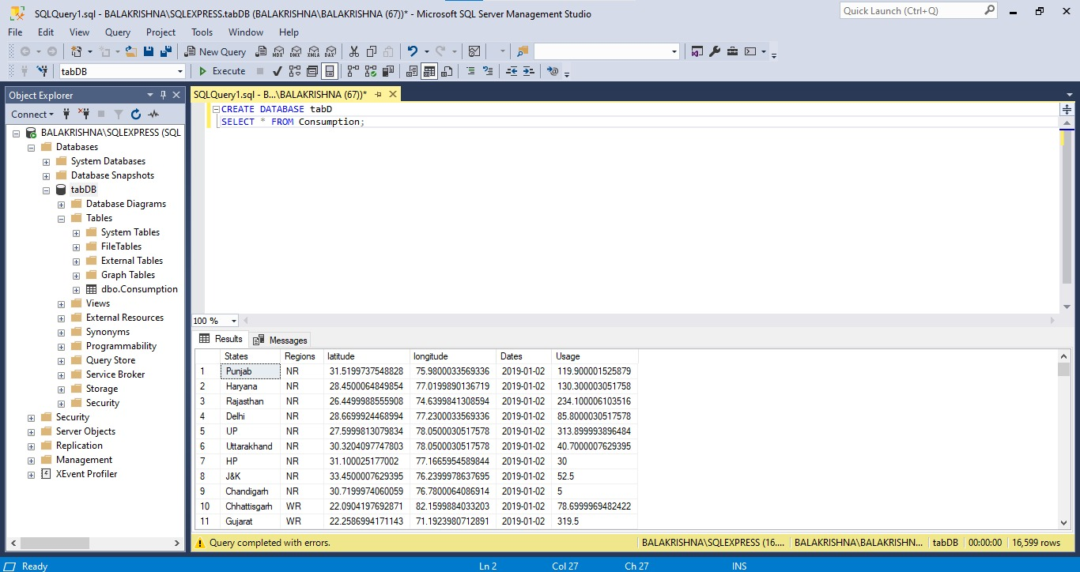
PERFORM SQL OPERATIONS USING SQL SERVER MANAGEMENT STUDIO

Slide 8
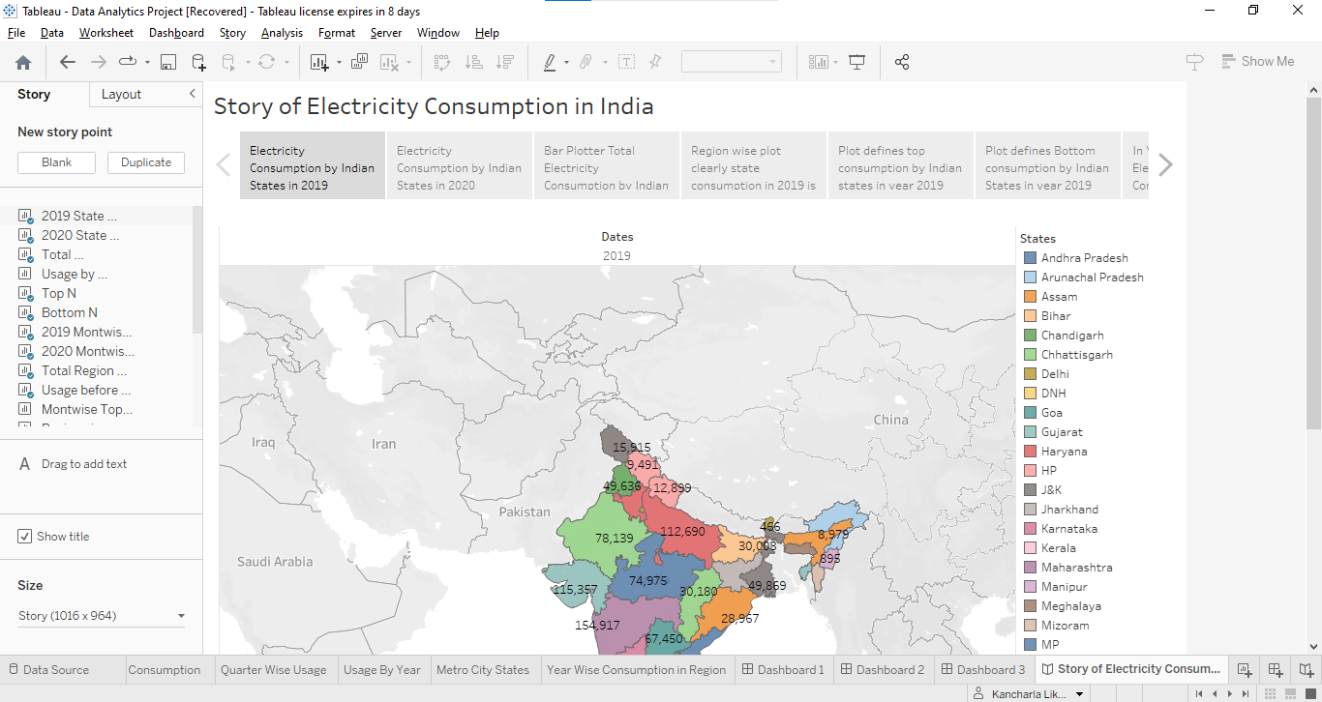
STORY CREATION

Slide 9
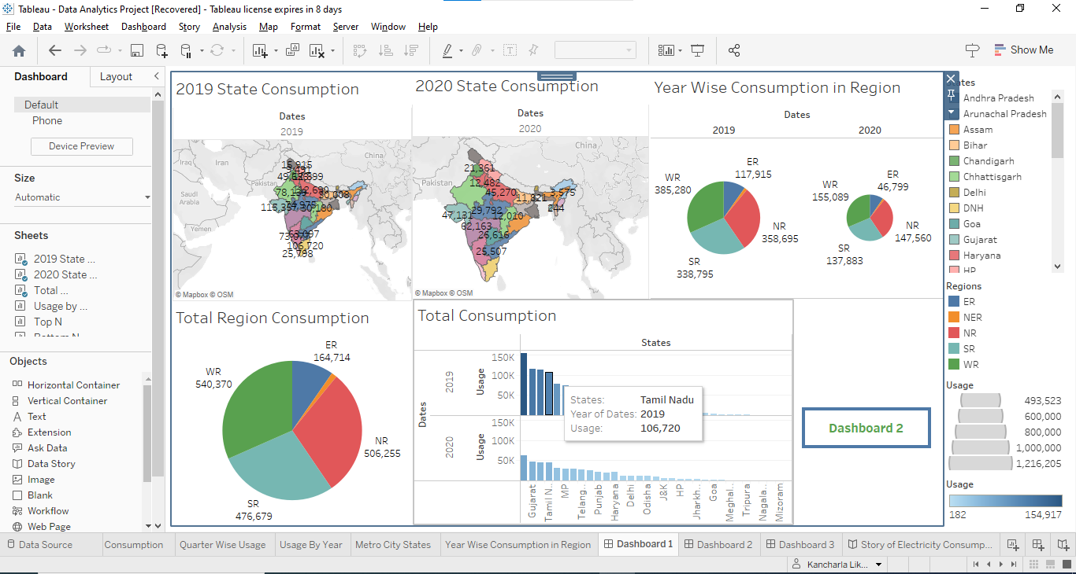
VISUALIZATION OF DATABASE
DASHBOARD CREATION

Slide 10
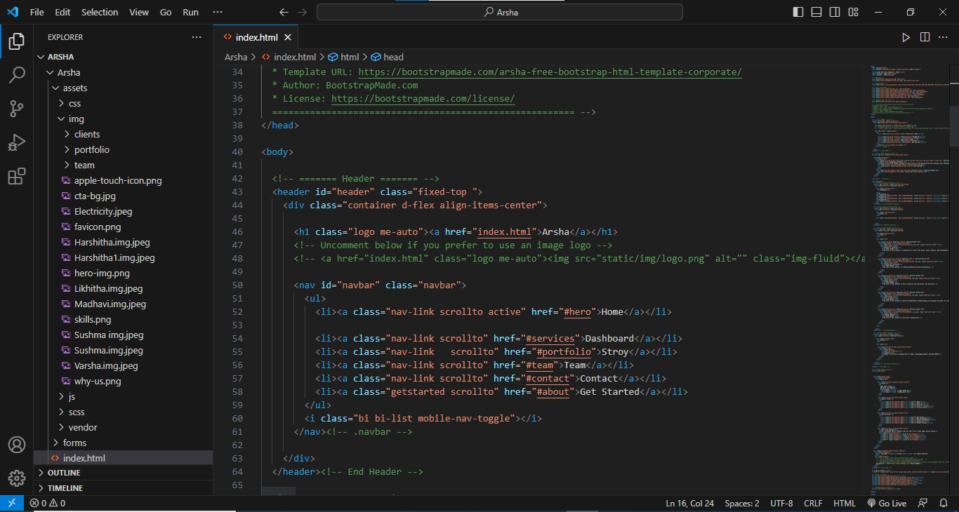
WEB PAGE CREATION

Slide 11
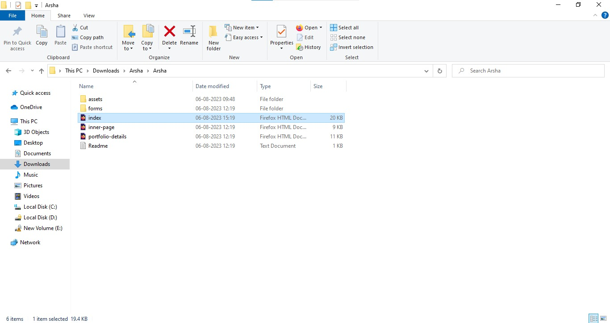
FOLDER FOR WEBPAGE

Slide 12
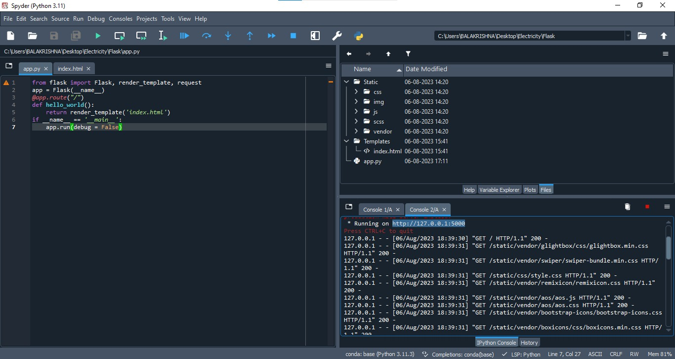
CONNECTION OF WEBPAGE
THE HIGHLIGHTED ONE IS THE WEB PAGE SERVER

Slide 13
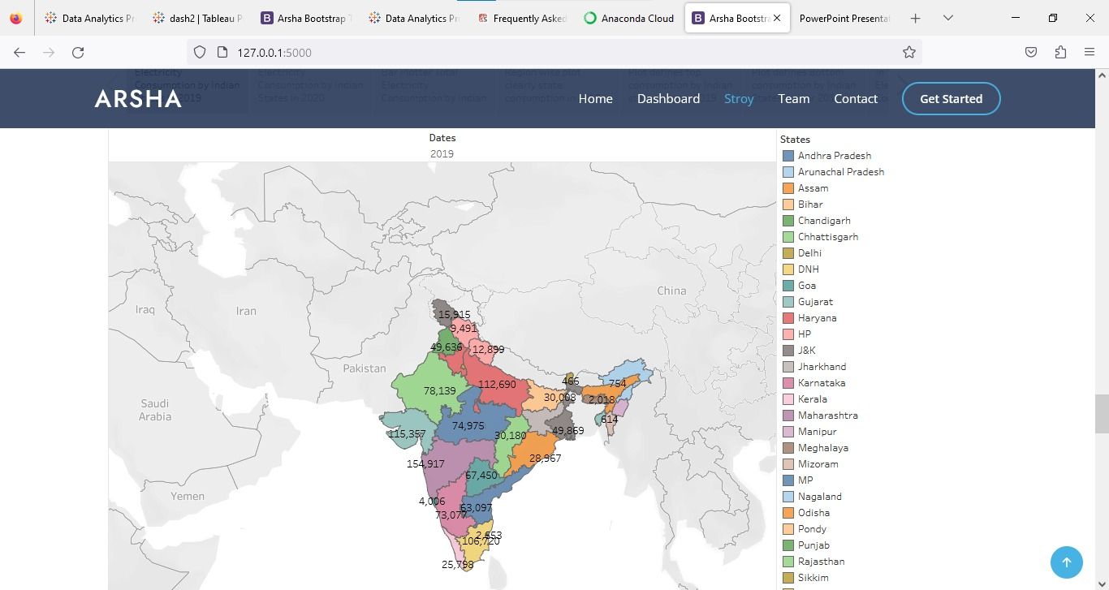
FINALLY THE WEBPAGE

Slide 14
THANK YOU

